Slide 1
BRACT’s Vishwakarma Institute of Information Technology Department of Engineering and Applied Sciences
A project on
‘HYDROGEN STORAGE BY USING NANOMATERIALS’
Course: Engineering Chemistry Lab (Semester I, 2020-21)
Submitted by : Batch: G3
Roll No. | PRN | Name of student | Contact No. | VIIT email ID
7049 | 22010802 | Rudraprasad Vishwamitre | 7057275412 | rudraprasad.22010802@viit.ac.in
7050 | 22010818 | Deep Jadhav | 8208124090 | deep.22010818@viit.ac.in
7062 | 22011010 | Dhaval Bora | 9561755549 | dhaval.22011010@viit.ac.in
7064 | 22011042 | Akshay Misal | 7744073260 | akshay.22011042@viit.ac.in

Slide 2
CONTENTS :
Objectives
Introduction
Synthesis of CNF
Experimental details
Observations and Results
Conclusion
Future scope

Slide 3
OBJECTIVES :
Introduction hydrogen storage in carbon material
Study of structural arrangements of carbon Nano filaments and their synthesis
Experimentally measured hydrogen storage capacities of carbon nanofibers
Treatments for improving storage capacities of different carbon materials
To study the hydrogen adsorption under the flow [ dynamically ] Results and discussion

Slide 4
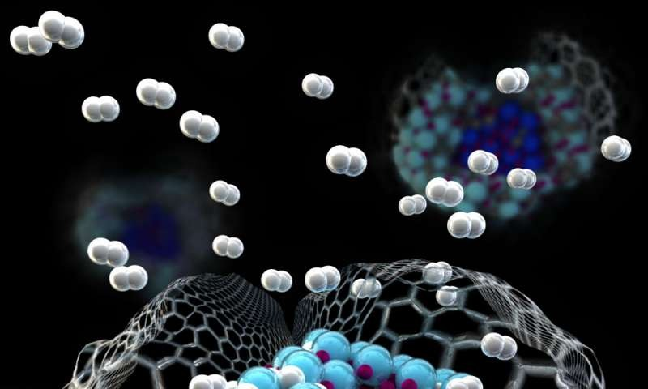
INTRODUCTION
carbon materials possess high hydrogen storage capacity due to porous microstructure with high specific surface area (SSA) and low mass density.
Hydrogen storage in Carbon material :
High hydrogen capacity
Less desorption
AC-5.5 wt%
Graphite - 4.48 wt%
SWCNT-4.5 wt%
MWCNT-6.3 wt%
CNF 6.5 wt%

Slide 5
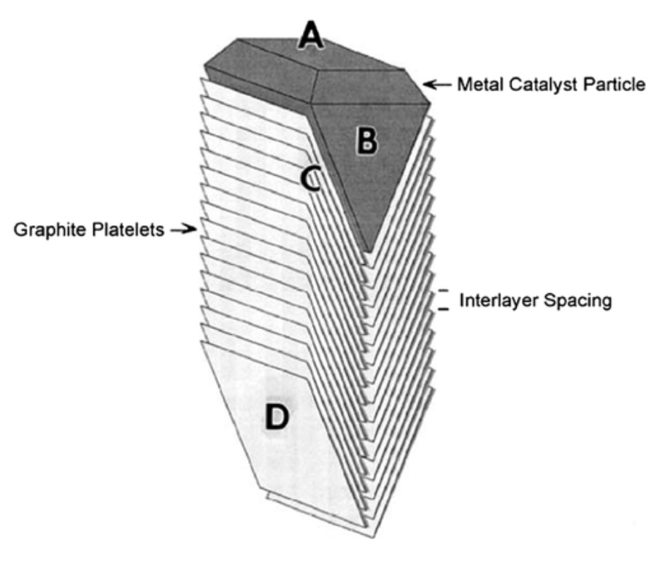
Synthesis of CNF
CNF structures can be formed at elevated temperatures from the mixture of carbon contained gases and hydrogen.
Different types of CNF with difference in morphology, crystalline structure, and shape are possible by varying nature and geometry of catalyst as well as reaction condition.
The surface A of catalyst particle B absorbs the hydrocarbon, where C-C bonds are broken.
Diffusion of carbon atom takes place at interface C, which lies between the platelets D and the catalyst particles, yielding carbon nanostructure.
Since the grown fibers are composed of CNFS and the catalyst particles, leaching the catalyst with acid purifies it. The platelets that formed during the entire process have graphite in majority.
Hence, the nanofibers are also known as CNFs. Less ordered carbon could also be generated depending on the crystal faces of catalyst.

Slide 6
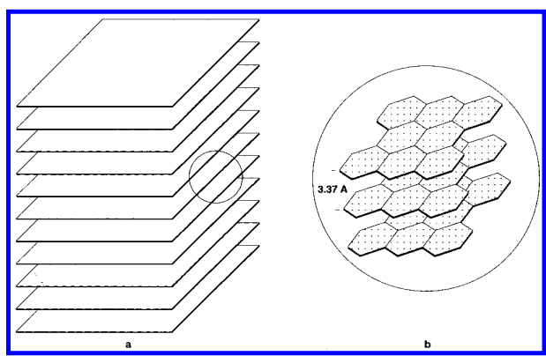
Storage of hydrogen in CNF(GNF)
An ideal solid for hydrogen storage should have slit-shaped nanopores having width higher than kinetic diameter of hydroge
Metal-intercalated graphite has been considered as a possible candidate for the storage of hydrogen
It has been reported that up to 0.137 L (STP) of hydrogen per gram of carbon can be adsorbed between the layers of alkali-intercalated graphite
No evidence of damage to the structure upon repeated adsorption and desorption cycles was observed at liquid nitrogen temperature
Graphite nanofibers are used as they have higher value adsorbed hydrogen.
These structures have an array of slit shaped pores separated by a distance greater than or equal to 3.35 Å
These structures possess the ideal configuration for use in the storage of hydrogen, whose kinetic diameter is only 2.89 Å
Fig 1 :- (a) Schematic representation of the arrangement of platelets in a catalytically grown graphite nanofiber; (b) an enlarged section showing the detail of area marked in (a)
Reference :- Fig 1

Slide 7
Storage of hydrogen in CNF(GNF)
The unit consists of a conventional high-pressure stainless steel sample cell
Approximately 0.2 g of was loaded into the sorption cell, and the sample was evacuated to 10^(-3) Torr while being heated to 150 °C
Hydrogen is introduced into the reservoir container and allowed to access with nanofibers
The drop in pressure of the system from an initial value of up to 112 atm was measured at regular intervals with a Cole Parmer meter.
The amount of hydrogen stored in graphite nanofibers was calculated from the changes in pressure
In a second set of experiments, an identical procedure was used to determine the hydrogen sorption characteristics
In the second set palladium powder, two metal alloys (LaNi5 and MnNi4.5Al0.5), and active carbon and graphite were used to determine the sorption
In all cases the experiments were performed at room temperature.
Reference:- fig 2

Slide 8
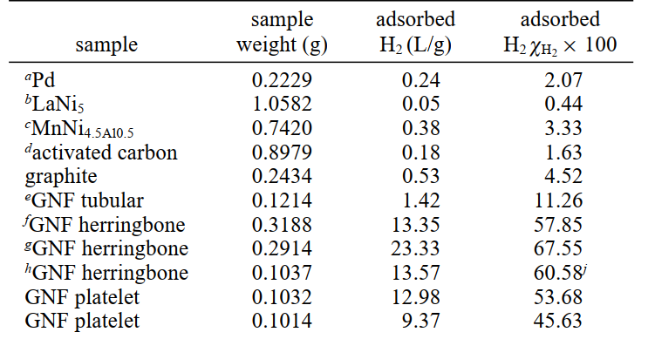
Storage of hydrogen in CNF(GNF)
Purified graphite nanofibers were allowed to interact with hydrogen at 25 °C and at a pressure 112 atm , a drop in pressure was observed over a period of 24 hours
The nature of different materials when exposed to hydrogen is shown in Graph 1
The observations noted are shown in Table 1
In these latter systems it is apparent that only modest changes in the pressure were it observed over the same time period.
The dramatic decrease in pressure that occurs in the presence of certain types of graphite nanofibers is at first sight overwhelming.
Indeed, in the best case a reduction of 71 atm was achieved in the presence of only 0.2914 g of nanofibers.
Table 1 : Adsorption Data for Selected Carbons and Hydrides

Slide 9
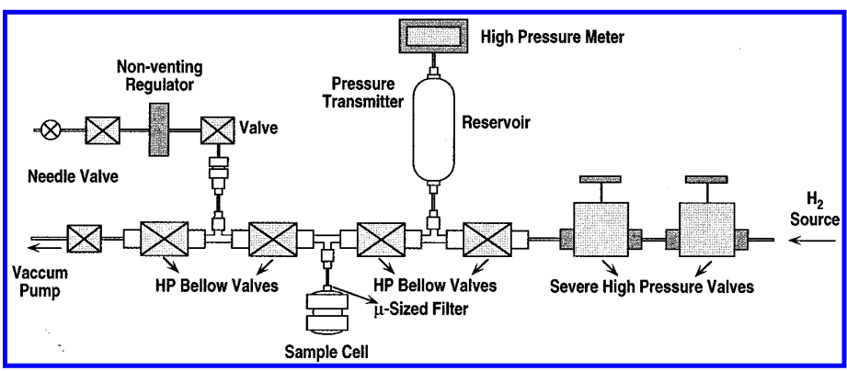
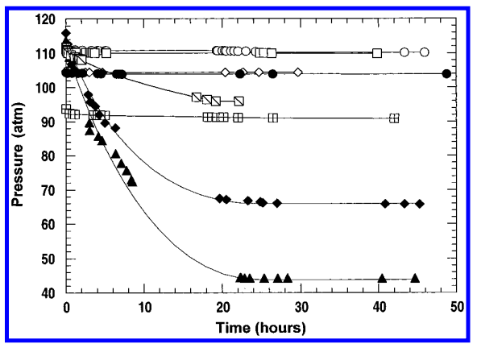
Storage of hydrogen in CNF(GNF)
Graph 1 :- Change in hydrogen pressure as a function of time in the presence of Pd , LaNi(5) , MnNi (4) . Al(0.5) , Norit activated carbon , GNF tubular , GNF herringbone
Fig 2 :- Schematic representation of the apparatus used for the measurement of hydrogen uptake in various materials

Slide 10
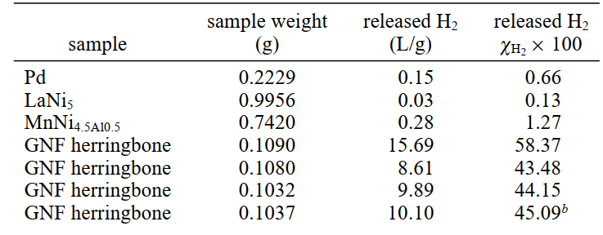
Desorption of adsorbed hydrogen
Desorption Data for Selected Carbons and Hydrides is shown in Table 2
There is a difference in the amount of hydrogen adsorbed and desorbed at room temperature from the graphite nanofibers
This observation suggests the possible existence of chemisorbed hydrogen
Table 2 :- Desorption Data for Selected Carbons and Hydrides

Slide 11
H2 adsorption study under flow (dynamic) conditions:
Fig. shows a schematic representation of the experimental setup used for the H2 adsorption study under dynamic (flow)conditions

Slide 12
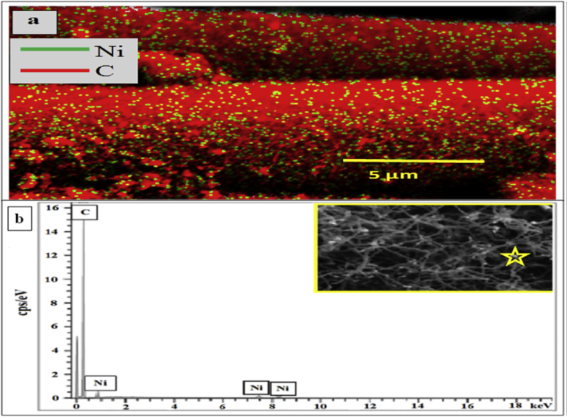
Results and discussion
Ni loading in Ni-ACF
Surface morphology and EDX analysis
area-EDX element mapping and
point – EDX of NI –ACF/CNF-m sample
SEM images of
(a, a') ACF, (b, b') Ni-ACF, (c, c') Ni-ACF/CNF,
(d, d') Ni-ACF/CNF-m and (e, e') ACF/CNF.

Slide 13
Conclusions
The ACF- and ACF/CNF-based adsorbents were prepared as an efficient H2-storage material.
The significance of the SBET or microporosity, graphitic CNFs and the inclusion of Ni in the material were experimentally demonstrated for different adsorption temperatures.
The ACF substrate, which contained the highest SBET, showed the highest capacity (3.40% (w/w) at 20 bar) at 77 K, indicating that the BET surface area or the microporosity of the adsorbent controlled H2-adsorption at cryogenic temperature. The steam modification of the Ni- ACF/CNF samples increased the BET surface area and microporosity content, which were decreased in the post-CNF grown samples, but retained the graphitic texture of the material. The adsorption capacity of such adsorbent (Ni- ACF/CNF-m) was highest at elevated temperatures and 50 bar (0.56% (w/w) at 273 K and 0.75% (w/w) at 298 K), attributed to the synergistic effects of the metal, CNF and large SBET of the material.
Also, the prepared adsorbents were effectively used as the packed bed materials for the adsorption of H2 under flow conditions.
This study has shown that the textural properties of the material, including its metal content and graphitic characteristics must be considered while selecting a suitable adsorbent as the H2 storage material

Slide 14
CHALLENGES IN USING HYDROGEN STORAGE :
Efficiency
Size
Safe storage
Cost for operation and Durability

Slide 15
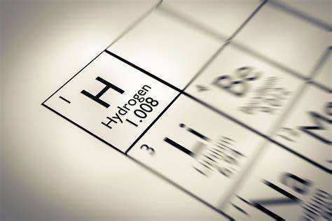
Future scope
Along with the continuous research on developing novel concepts and technologies with renewable energy application, in the past decades there have been numerous attempts to develop nanomaterials to achieve applicable renewable energy conversion and utilization.
The concepts of nanomaterial design for high efficiency photocatalytic/photoelectrochemical solar hydrogen conversion, high capacity hydrogen storage, and effective electricity generation from fuel cells.
Although there are still many challenges ahead in these areas, the review article presented here demonstrates that nanomaterial design is important for future research into these selected technologies for renewable energy.
It is anticipated that new strategies and advanced functional nanomaterials will continue to emerge due to the active research and development of the hydrogen storage, which would contribute significantly to a successful implementation of the hydrogen economy vision.

Slide 16
REFRENCES
Hydrogen storage in carbon materials—A review
Hydrogen Storage in Carbon Nanofibers
Nickel nanoparticle-doped and steam-modified multiscale structure of carbon micro-nanofibers for hydrogen storage: Effects of metal, surface texture and operating conditions
Hydrogen storage - Wikipedia

